Slide 1
AI-Based Travel Itinerary Maker
Revolutionizing Travel Planning with Gen AI

Slide 2
Introduction
Overview
Vision
Planning
Overview of the Travel Itinerary Maker
What’s the Purpose Vision of Itnery Maker
How it Simplifies Travel Planning

Slide 3
Travel Infographics
30cr
10%
5%
Approximately $400,000 is spent on travel bookings worldwide every minute.
Contributed $8.9 trillion to the global economy in 2019,
In 2019, there were 1.4 billion international tourist arrivals

Slide 4
Challenges in Travel Planning
Time-Consuming Research
Planning a trip involves extensive research to find the best flights, accommodations, activities, and dining options, which can be very time-consuming.
Lack of Personalized Recommendations
Traditional travel planning tools often provide generic suggestions that do not cater to individual preferences.
Overwhelming Amount of Information
The abundance of travel-related information available online can be overwhelming, making it difficult for travelers to make informed decisions.

Slide 5
Solution Offered
AI-Driven, Customized Travel Itineraries
Seamless Integration of User Preferences

Slide 6






Technology Stack

Slide 7
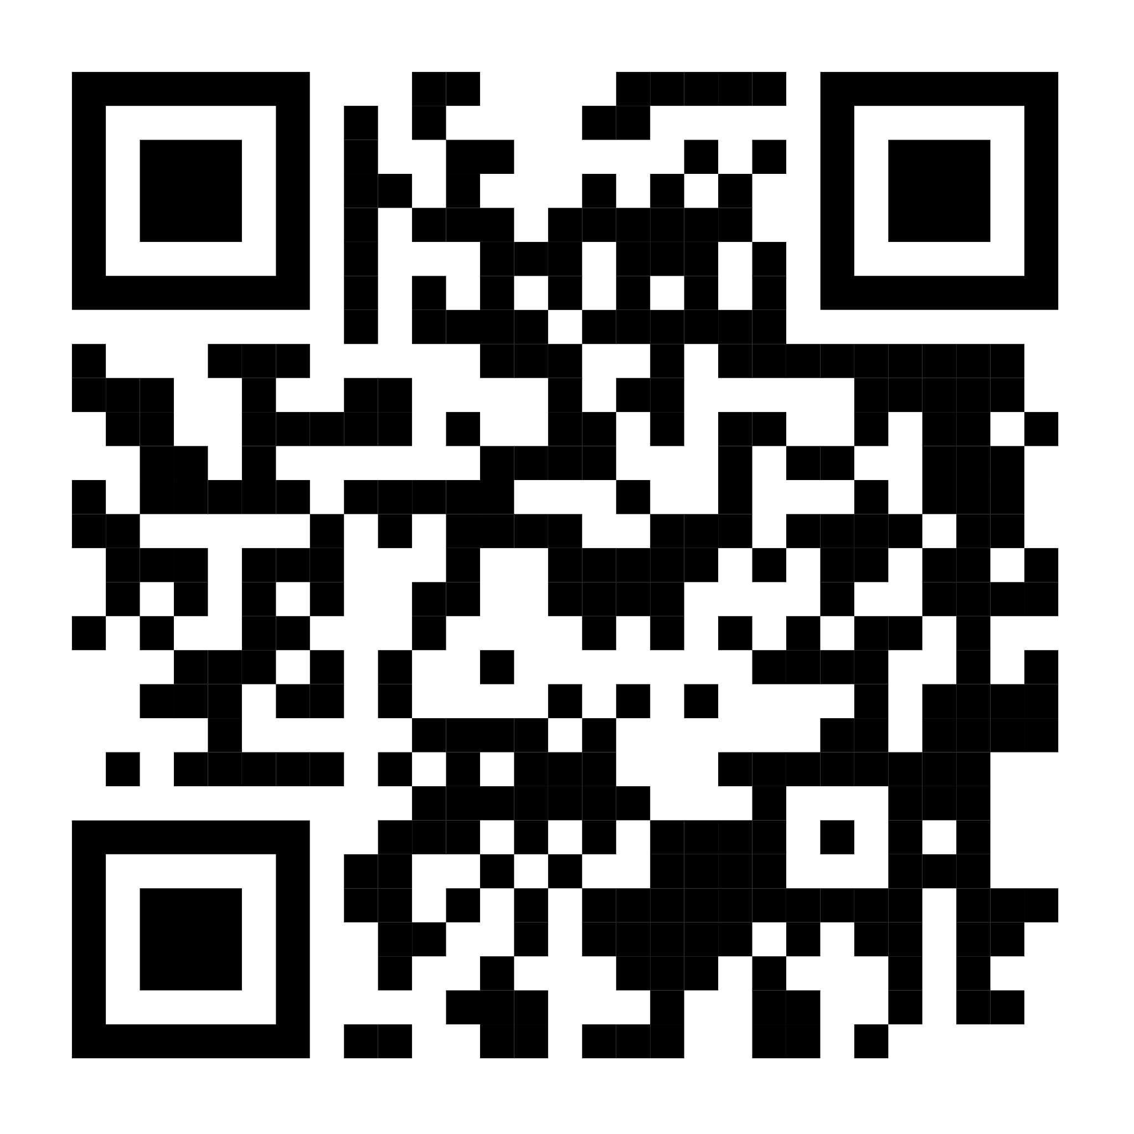
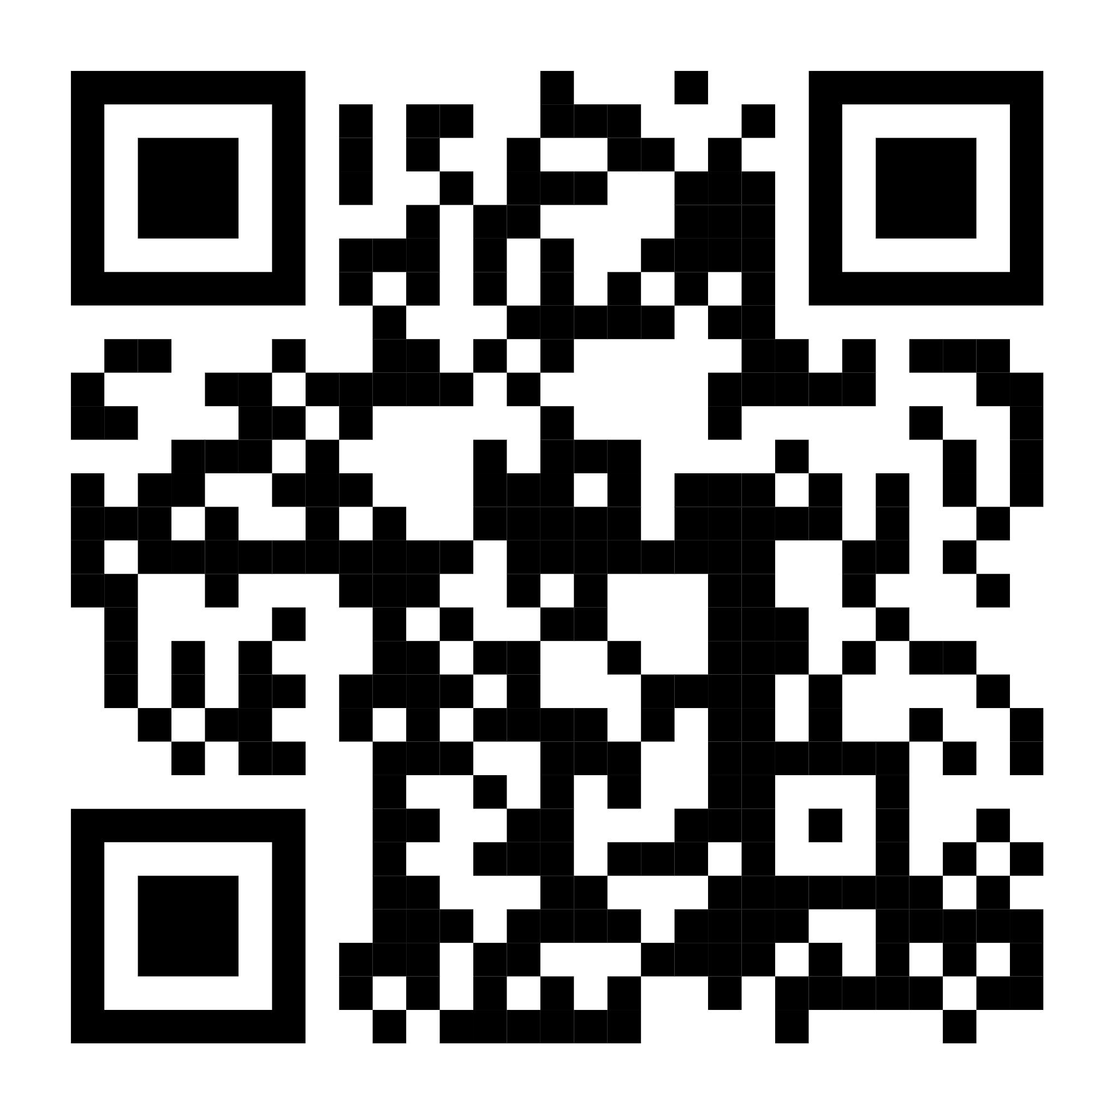
Demonstration
Scan QR for Android App
Scan QR for Website

Slide 8
Key Features of the Itinerary Maker
Integration with Google Gemini for real-time data
AI-driven travel recommendations
06
01
User-friendly interface
Seamless booking options: Business For Travel Agency
05
02
Multi-platform support (web and mobile)
Customizable itineraries
04
03

Slide 9
Benefits & Impact
1
2
3
User Perspective
Market Impact
Convergence
Time-saving
Personalized travel experiences
Hassle-free planning
Potential market reach
Competitive advantage
Increases Customer conversion ratio.
Gives business to Travel Agent.

Slide 10
Research Paper
Valentina Alto, Building LLM Powered Applications: Create intelligent apps and agents with large language models , Packt Publishing, 2024.
Evan Hahn, Express in Action: Writing, building, and testing Node.js applications , Manning, 2016.
1
2

Slide 11
Q&A
When do you want to travel?
SUN
MON
TUE
WEN
THU
FRI
SAT
1
2
3
4
5
6
7
8
9
10
11
12
13
14
15
16
17
18
19
20
21
22
23
24
25
26
27
28
29
30
31

Slide 12
Thank You

